Slide 1
Implementation of Multilayer Perceptron fro Scratch
Eng Teong Cheah

Slide 2
Objective
We saw that implementing a simple MLP is easy, even when done manually. That said, with a large number of layers, this can get messy (e.g. naming and keeping track of the model parameters, etc).

Slide 3
Contents
1. Implementation of Multiplayer Perceptron from Scratch 2. Initialize Model Parameters 3. Activation Function 4. The model 5. The Loss Function 6. Training

Slide 4
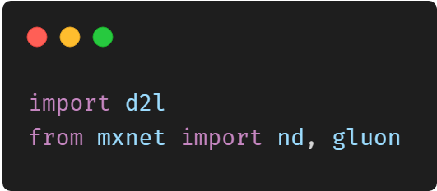
Implementation of Multilayer Perceptron from Scratch

Slide 5
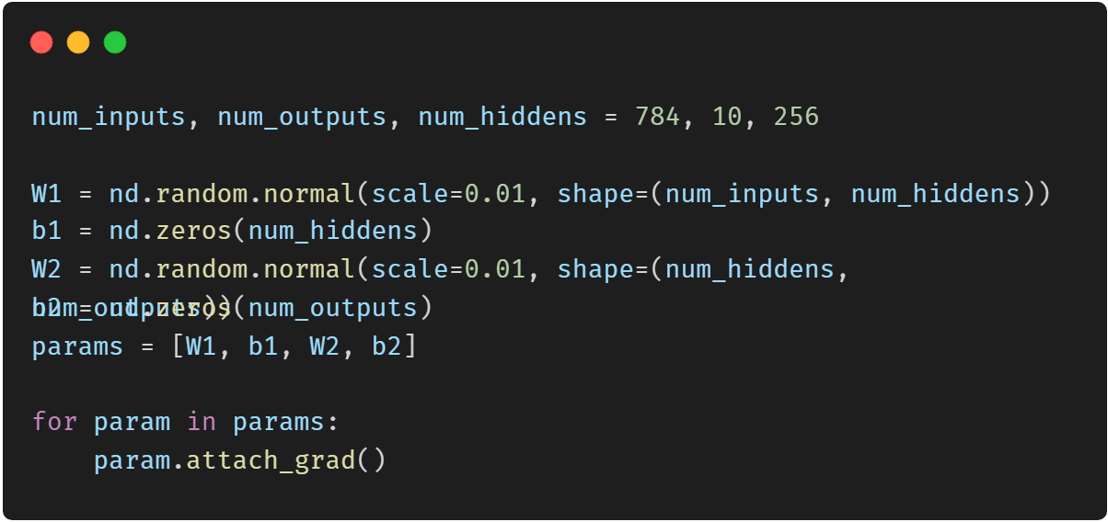
Initialize Model Parameters

Slide 6
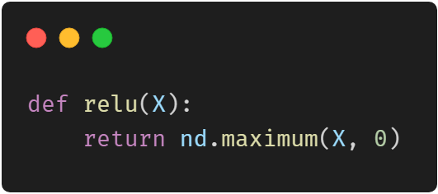
Activation Function

Slide 7
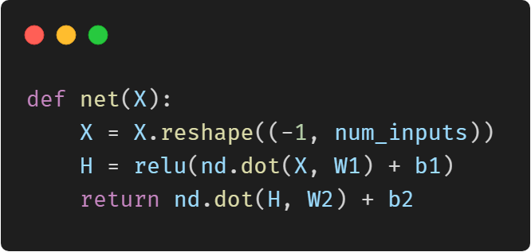
The model

Slide 8
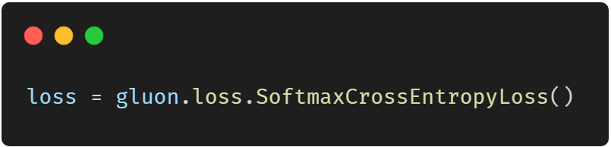
The Loss Function

Slide 9
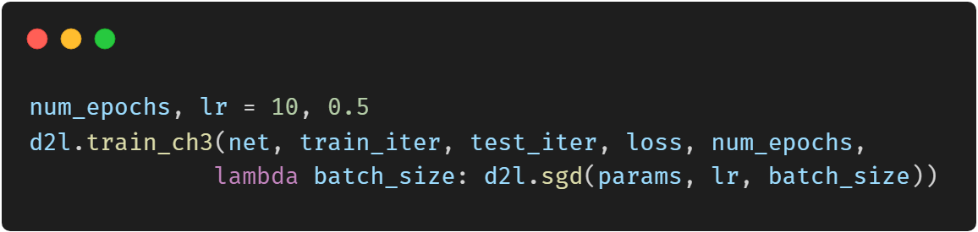
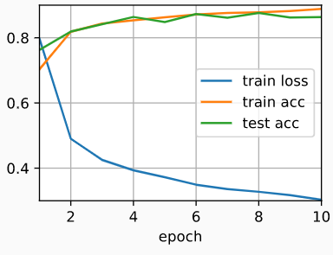
Training

Slide 10
Thank You！
Does anyone have any questions?
Twitter: @walkercet
Blog: https://ceteongvanness.wordpress.com

Slide 11
Resources
Dive into Deep Learning

